Slide 1


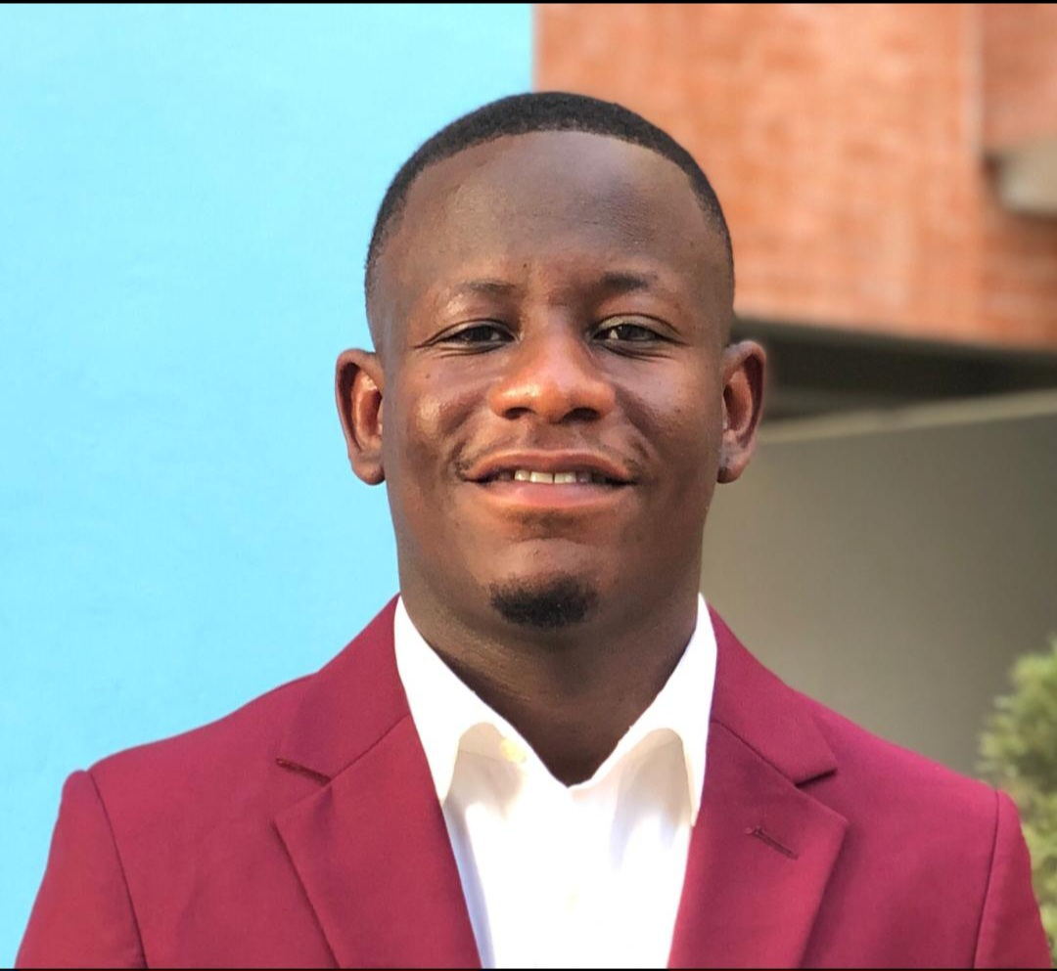
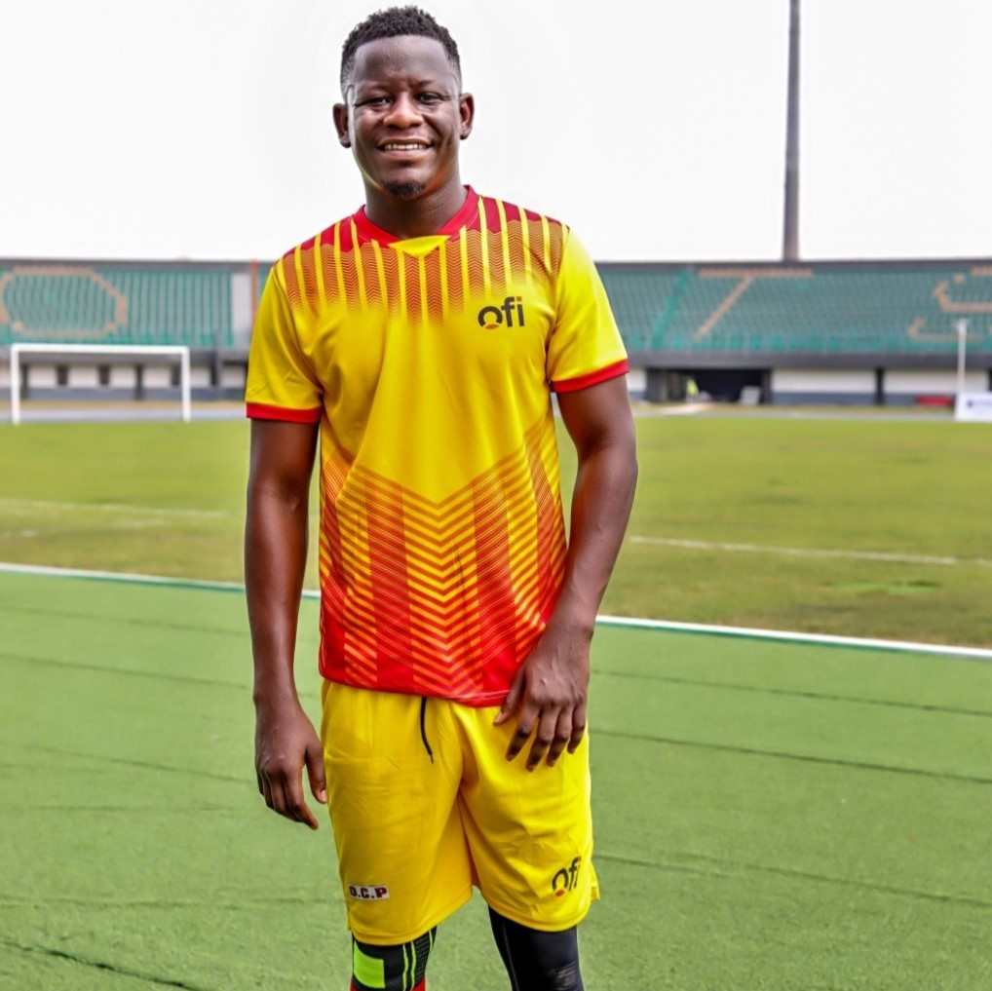
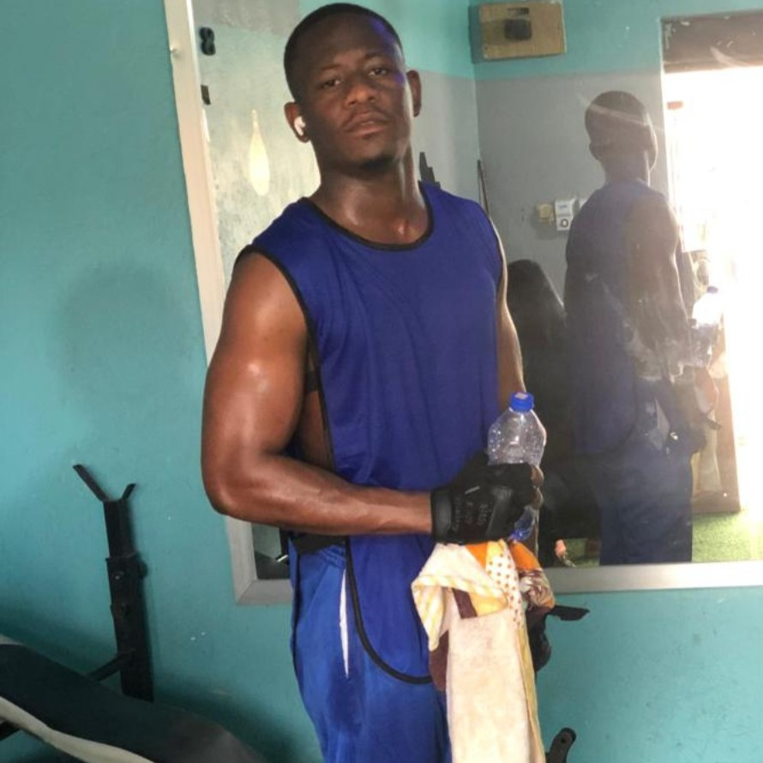
Getting to Know Me
Work
Personal
My role
Enterprise Application Support Lead Ghana & Burkina
Significant others / family members / furry friends in my life
My wife, son and my parents
Tenure in ofi/Olam
SIX (6) years
How I enjoy spending my free time
I like to work out at the gym, play football or try out some new cooking recipes
Previous companies I have worked at
Ministry of food and Agric, EL FX trading
My favorite / comfort food
Banku with Tilapia
Why I joined ofi/Olam and what keeps me here?
I joined Olam/Ofi because of the career growth opportunities it offered, exciting projects and the positive company culture, which makes ofi an attractive place to work. I am still here because we have a supportive team and also learning opportunities to enhance my skill set
My favorite song
lean on me by Michael Bolton
Mubarak Essien
Mubarak
A few fun facts about me
I am a fitness enthusiast
I love playing football
I enjoy cooking and experimenting with new ingredients and techniques.
This is me outside work, doing stuff I enjoy in my life …

